Slide 1
CHAPTER 2
Database System Concepts and Architecture

Slide 2
MOTİVATİON
Database used to be about boring stuff:
  employee records, bank records, etc.
Today, the field covers all the largest sources of data, with many new ideas.
  Web search.
  Data mining.
  Scientific and medical databases.
  Integrating information.
You may not notice it, but databases are behind almost everything you do on the Web.
  Google searches. Queries at Amazon, eBay, etc.
Slide 2-<number>
http://infolab.stanford.edu/~ullman/fcdb/aut07/slides/intro.pdf

Slide 3
DATABASE CONTENTS
User data
Metadata
  Describe our data
Indexes and other overhead data
  Tables of data to improve performance of access, how users are interacting with databases, track the status of databases
Application metadata
Slide 2-<number>

Slide 4
DATA MODELS
Data Model: A set of concepts to describe the structure of a database, and certain constraints that the database should obey.
  Data types, relationships, and constraints that should hold for the data
It may be performed in multiple phases of projects.
Slide 2-<number>

Slide 5
DATA MODELS
Database vs. files
  A file can have a complex inner structure, but the definition of that structure is not within the file; it is in the programs that create or use the file.
  A data model is contained in the database it describes. It travels with the database and is available to any program that uses the database. The model defines not only the names of the data items but also their data types, so a program can adapt itself to the database.
    For example, a program can find out that, in the current database, a price item is a decimal number with eight digits, two to the right of the decimal point; then it can allocate storage for a number of that type.
Slide 2-<number>
http://publib.boulder.ibm.com/infocenter/idshelp/v10/index.jsp?topic=/com.ibm.sqlt.doc/sqltmst43.htm
Notes:
For example, a document file that a word-processing program stores might contain detailed structures that describe the format of the document. However, only the word-processing program can decipher the contents of the file, because the structure is defined within the program, not within the file.
For example, a program can find out that, in the current database, a price item is a decimal number with eight digits, two to the right of the decimal point; then it can allocate storage for a number of that type.

Slide 6
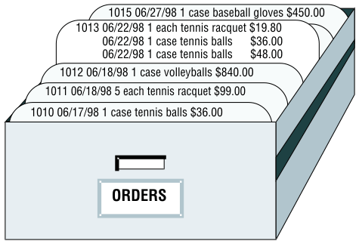
DATA MODELS
Database vs. files
  A file can be searched sequentially.
  When you query a database, you use the terms that the data model defines.
    What orders have been placed for products made by the Shimara Corporation, by customers in New Jersey, with ship dates in the third quarter?
    http://publib.boulder.ibm.com/infocenter/idshelp/v111/index.jsp?topic=/com.ibm.sqlt.doc/sqlt22.htm
Slide 2-<number>
Notes:
In other words, when you access data that is stored in a file, you must state your question in terms of the physical layout of the file. When you query a database, you can ignore the arcane details of computer storage and state your query in terms that reflect the real world, at least to the extent that the data model reflects the real world.

Slide 7
DATA MODELS
Database vs. files
  The data model also makes it possible to modify the contents of the database with less chance for error.
    E.g. "Find every stock item with a manufacturer of Presta or Schraeder, and increase its price by 13 percent.“
      You state changes in terms that reflect the meaning of the data.
      You do not have to waste time and effort thinking about details of fields within records in a file, so the chances for error are fewer.
    http://publib.boulder.ibm.com/infocenter/idshelp/v111/index.jsp?topic=/com.ibm.sqlt.doc/sqlt22.htm
Slide 2-<number>

Slide 8
DATA MODELS
What makes a Data Model?
1. Mathematical representation of data.
  Examples:
  relational model = tables;
  semi structured model = trees/graphs.
  (e.g. how data is contained in databases and how relationship between data is described)
2. Operations on data
  E.g. update, query operations
3. Constraints
  E.g. students numbers starting with ”e” and followed by 7 digits
Slide 2-<number>

Slide 9
DATA MODELS
EXAMPLE: A RELATION IS A TABLE.
Relation
name
PainKiller
Attributes
(column
headers)
name manf
Appranax Abdi İbrahim İlaç San
Advil Pfizer
Aspirin Bayer Türk Kimya San.
Tuples
(rows)
(records)
Slide 2-<number>
Notes:
Reference: http://infolab.stanford.edu/~ullman/fcdb/aut07/index.html#lecture

Slide 10
DATA MODELS
Data Model Operations: Operations for specifying database retrievals and updates by referring to the concepts of the data model.
Operations on the data model may include basic operations and user-defined operations.
  E.g.
    User defined operation called, for example, COMPUTE_GPA defined on the STUDENT
    Generic operations such as insert, delete, modify or retrieve

Slide 11
CATEGORIES OF DATA MODELS
Conceptual (high-level, semantic) data models: Provide concepts that are close to the way many users perceive data.
  Also called entity-based or object-based data models.
  Conceptual data models use concepts such as entities, attributes and relationships.
Physical (low-level, internal) data models: Provide concepts that describe details of how data is stored in the computer.
  Example: record formats, record orderings
Implementation (representational) data models: Provide concepts that fall between the above two, balancing user views with some computer storage details.
  Example: relational data model
Slide 2-<number>
Notes:
Many data models have been proposed, which we can categorize according to the types of concepts they use to describe the database structure.
Conceptual data models use concepts such as entities, attributes and relationships.

Slide 12
CATEGORIES OF DATA MODELS: EXAMPLE FOR DESIGNING AND BUILDING AND HOME
Conceptual (high-level, semantic) data models: Provide concepts that are close to the way many users perceive data.
Implementation (representational) data models: Provide concepts that fall between the above two, balancing user views with some computer storage details.
  Example: relational data model
Physical (low-level, internal) data models: Provide concepts that describe details of how data is stored in the computer.
  Example: record formats, record orderings
Requirements: How many bedrooms you want to have, bathrooms (en-süit or not), number of floors et.
Architecture details the design by including where the plumbing fixtures will be placed, size of rooms etc.
Builders build your home
Slide 2-<number>
Notes:
Many data models have been proposed, which we can categorize according to the types of concepts they use to describe the database structure.
Conceptual data models use concepts such as entities, attributes and relationships.

Slide 13
CATEGORIES OF DATA MODELS: EXAMPLE FOR DATABASE
Specify business high-level requirements such as what views admins and users will see in a home security system. What alerts will be generated and sent.
Conceptual (high-level, semantic) data models: Provide concepts that are close to the way many users perceive data.
Implementation (representational) data models: Provide concepts that fall between the above two, balancing user views with some computer storage details.
  Example: relational data model
Physical (low-level, internal) data models: Provide concepts that describe details of how data is stored in the computer.
  Example: record formats, record orderings
Architectural decisions –what type of database you will use (relational, document based, spatial?), the features of design (camera properties, home location, sensor output and type)
Low level detailed implementation
Slide 2-<number>

Slide 14
SCHEMAS VERSUS INSTANCES
Relation schema = relation name and attribute list.
  Optionally: types of attributes.
  Example: PainKillers(name, manf)
  PainKillers(name: string, manf: string)
Database = collection of relations.
  Database schema = set of all relation schemas in the database.
    Description of a database
    Specified during database design
Slide 2-<number>
Notes:
Reference: http://infolab.stanford.edu/~ullman/fcdb/aut07/index.html#lecture
http://psychology.about.com/od/sindex/g/def_schema.htm

Slide 15
Schema Diagram: A diagrammatic display of (some aspects of) a database schema.
Schema Construct: A component of the schema or an object within the schema, e.g., STUDENT, COURSE.
Student
Name | StudentNumber | Class | Major
Section
SectionIdentifier | CourseNumber | Semester | Year | Instructor
Grade Report
StudentNumber | SectionIdentifier | Grade
Schema constructs
Schema diagram

Slide 16
SCHEMAS VERSUS INSTANCES
Schema Diagram: A diagrammatic display of (some aspects of) a database schema.
Schema Construct: A component of the schema or an object within the schema, e.g., STUDENT, COURSE.
Database Instance: The actual data stored in a database at a particular moment in time. Also called database state (or occurrence).
Slide 2-<number>

Slide 17
EXAMPLE: DATABASE INSTANCE
Suppose we have the following information in our database:
Name | StudentNumber | Class | Major
Smith | 17 | 1 | CS
Brown | 8 | 2 | CS
Student
SectionIdentifier | CourseNumber | Semester | Year | Instructor
85 | MATH2410 | Fall | 98 | King
92 | CS1310 | Fall | 98 | Anderson
102 | CS3320 | Spring | 99 | Knuth
112 | MATH2410 | Fall | 99 | Chang
119 | CS1310 | Fall | 99 | Anderson
135 | CS3380 | Fall | 99 | Stone
Database instance
Section
StudentNumber | SectionIdentifier | Grade
17 | 112 | B
17 | 119 | C
8 | 85 | A
8 | 92 | A
8 | 102 | B
8 | 135 | A
Grade Report
Slide 2-<number>
Slide 1-<number>

Slide 18
DATABASE SCHEMA VS. DATABASE STATE
Database State: Refers to the content of a database at a moment in time.
Initial Database State: Refers to the database when it is loaded
Valid State: A state that satisfies the structure and constraints of the database.
Distinction
  The database schema changes very infrequently. The database state changes every time the database is updated.
Slide 2-<number>
Notes:
DBMS stores descriptions of the schema constructs and constraints also called the metadata.

Slide 19
THREE-SCHEMA ARCHITECTURE
Proposed to support DBMS characteristics of:
  Program-data independence.
  Support of multiple views of the data.
Slide 2-<number>
Notes:
Three of the four important characteristics of the database approach are (1) insulation of programs and data (program-data and program-operation independence (2) support of multiple user views and (3) use of a catalog to store the database description (schema)

Slide 20
THREE-SCHEMA ARCHITECTURE
Defines DBMS schemas at three levels:
  Internal schema at the internal level to describe physical storage structures and access paths. Typically uses a physical data model (managed by the system itself).
  Conceptual schema at the conceptual level to describe the structure and constraints for the whole database for a community of users. Uses a conceptual or an implementation data model.
  External schemas at the external level to describe the various user views. It describes the part of the database that a particular user group is interested in and hides the rest of the database from that user group.Usually uses the same data model as the conceptual level.
Slide 2-<number>
Notes:
The conceptual level has a conceptual schema, which describes the structure of the whole database for a community of users. The conceptual schema hides the details of physical storage structures and concentrates on describing entities, data types, relationships, user operations and constraints.
Each “external schema” describes the part of the database that a particular user group is interested in and hides the rest of the database from the user group.
Schema is defined as a diagrammatic representation.

Slide 21
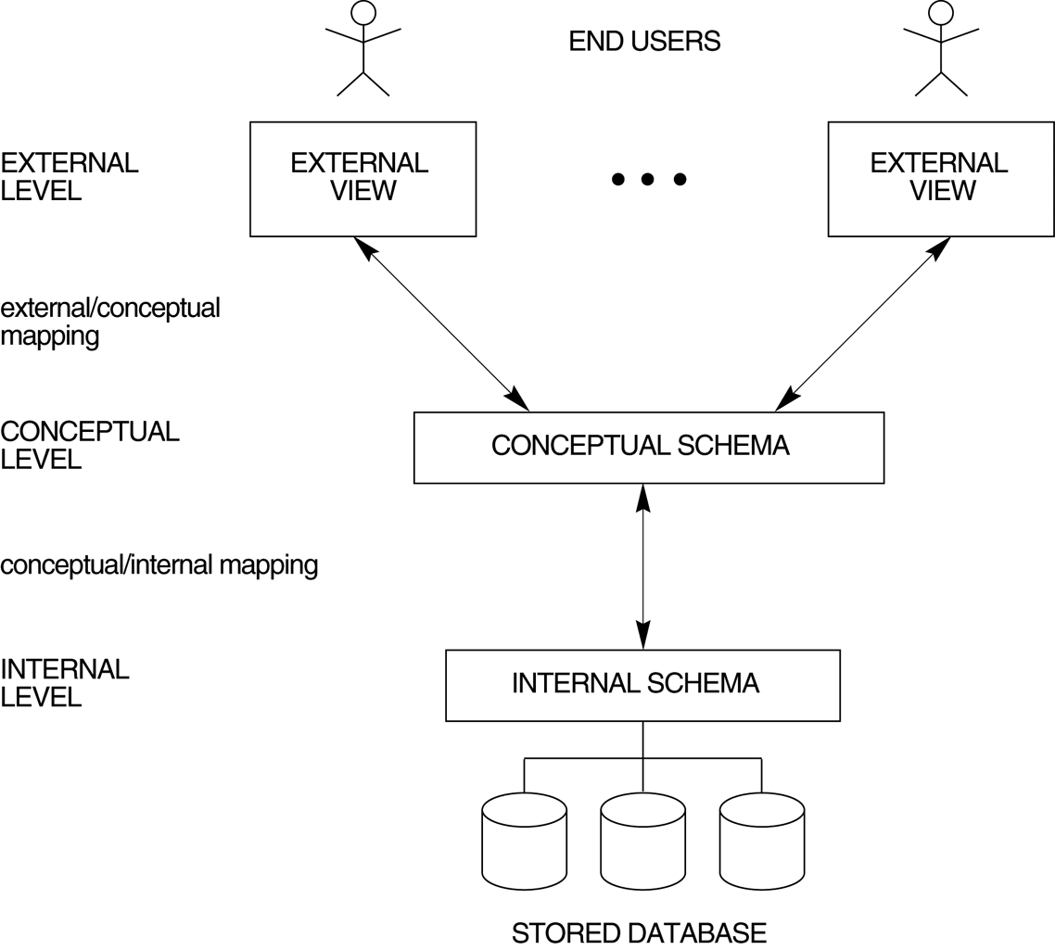
THREE-SCHEMA ARCHITECTURE
Slide 2-<number>

Slide 22
THREE-SCHEMA ARCHITECTURE: EXAMPLE
Student affairs system contains Student, Course, StudentEnrollCourse relations. Course includes courseID, courseName attributes – feature data types are implemented
Implementation/ conceptual data model: Relational data model
Slide 2-<number>

Slide 23
THREE-SCHEMA ARCHITECTURE: EXAMPLE
Student affairs system external schema contains views which combine multiple tables (Student, Course, StudentEnrollCourse) for transcript creation and views designed for security purposes.
Conceptual data model: .. Each student will see his/her own record.
Instructors create their courses.
Students receive their transcripts.
Slide 2-<number>

Slide 24
EXAMPLE
Suppose we have the following information in our database:
Student
Name | StudentNumber | Class | Major
Smith | 17 | 1 | CS
Brown | 8 | 2 | CS
SectionIdentifier | CourseNumber | Semester | Year | Instructor
85 | MATH2410 | Fall | 98 | King
92 | CS1310 | Fall | 98 | Anderson
102 | CS3320 | Spring | 99 | Knuth
112 | MATH2410 | Fall | 99 | Chang
119 | CS1310 | Fall | 99 | Anderson
135 | CS3380 | Fall | 99 | Stone
Section
StudentNumber | SectionIdentifier | Grade
17 | 112 | B
17 | 119 | C
8 | 85 | A
8 | 92 | A
8 | 102 | B
8 | 135 | A
Grade Report
Slide 1-<number>

Slide 25
EXAMPLE
One view for those who want to see the transcript of the students
StudentName | Student Transcript
 | CourseNumber | Grade | Semester | Year | SectionId
Smith | CS1310 | C | Fall | 99 | 119
 | MATH2410 | B | Fall | 99 | 112
Brown | MATH2410 | A | Fall | 98 | 85
 | CS1310 | A | Fall | 98 | 92
 | CS3320 | B | Spring | 99 | 102
 | CS3380 | A | Fall | 99 | 135
Slide 1-<number>
External Schema comprises the name and features of the table.

Slide 26
THREE-SCHEMA ARCHITECTURE
Each user group refers to its own external schema.
DBMS must transform a request on an external schema into a request on conceptual schema and then into request on internal schema for processing.
The processes of transforming requests and results between levels are called mappings.
Mappings among schema levels are needed to transform requests and data.
  Programs refer to an external schema, and are mapped by the DBMS to the internal schema for execution.
Slide 2-<number>
Notes:
Each user group refers to its own external schema. DBMS must transform a request on an external schema into a request on conceptual schema and then into request on internal schema for processing.
Data exists only at physical level. 3 schemas are only descriptions of data.

Slide 27
DATA INDEPENDENCE
The three-schema architecture can be used to further explain the concept of data independence.
  Logical Data Independence: The capacity to change the conceptual schema without having to change the external schemas and their application programs.
  Physical Data Independence: The capacity to change the internal schema without having to change the conceptual schema.
Slide 2-<number>

Slide 28
DATA INDEPENDENCE
When a schema at a lower level is changed, only the mappings between this schema and higher-level schemas need to be changed in a DBMS that fully supports data independence.
The higher-level schemas themselves are unchanged.
Hence, the application programs need not be changed since they refer to the external schemas.
Slide 2-<number>

Slide 29
DBMS LANGUAGES
Data Definition Language (DDL): Used by the DBA and database designers to specify the conceptual schema of a database. In many DBMSs, the DDL is also used to define internal and external schemas (views).
  Example:
    CREATE DATABASE employees
    DROP DATABASE employees
In some DBMSs, separate storage definition language (SDL) and view definition language (VDL) are used to define internal and external schemas.
Slide 2-<number>
Notes:
IN DBMSs where a clear separation is maintained between the conceptual and internal levels, the DDL is used to specify the conceptual schema only. Another language SDL, is used to specify the internal schema. The mappings between the two schemas may be specified in either one of these languages. For a true three-schema architecture, we would need a third language, the view definition language, to specify user views and their mappings to the conceptual schema, but in most DBMSs the DDL is used to define both conceptual and external schemas.

Slide 30
DBMS LANGUAGES
Data Manipulation Language (DML): Used to specify database retrievals and updates.
  DML commands (data sublanguage) can be embedded in a general-purpose programming language (host language), such as COBOL, C or an Assembly Language.
  Alternatively, stand-alone DML commands can be applied directly (query language).
Slide 2-<number>
Notes:
In current DBMSs the preceding types of languages are usually not considered distinct languages; rather a comprehensive integrated language is used that includes constructs for conceptual schema definition, view definition, and data manipulation. A typical example of a comprehensive database language is the SQL relational database language.

Slide 31
DBMS LANGUAGES
There are two main types of DMLs:
  High Level or Non-procedural Languages: e.g., SQL, are set-oriented and specify what data to retrieve than how to retrieve. Also called declarative languages.
  Low Level or Procedural Languages: record-at-a-time; they specify how to retrieve data and include constructs such as looping.
Slide 2-<number>

Slide 32
DBMS INTERFACES
Stand-alone query language interfaces.
Programmer interfaces for embedding DML in programming languages:
  Pre-compiler Approach
  Procedure (Subroutine) Call Approach
User-friendly interfaces:
  Menu-based, popular for browsing on the web
  Forms-based, designed for naïve users
  Graphics-based (Point and Click, Drag and Drop etc.)
  Natural language: requests in written English
  Combinations of the above
Slide 2-<number>

Slide 33
OTHER DBMS INTERFACES
  Speech as Input and Output
  Web Browser as an interface
  Parametric interfaces (e.g., bank tellers) using function keys.
  Interfaces for the DBAdmins:
    Creating accounts, granting authorizations
    Setting system parameters
    Changing schemas or access path
Slide 2-<number>

Slide 34
DATABASE SYSTEM UTILITIES
Most DBMSs have database utilities that help the DBA in managing the database systems.
To perform certain functions such as:
  Loading data stored in files into a database. Includes data conversion tools.
  Backing up the database periodically on tape.
  Reorganizing database file structures.
  Report generation utilities.
  Performance monitoring utilities.
  Other functions, such as sorting, user monitoring, data compression, etc.
Slide 2-<number>
Notes:
Most DBMSs have database utilities that help the DBA in managing the database systems.

Slide 35
OTHER TOOLS
Data dictionary / repository:
    Used to store schema descriptions and other information such as design decisions, application program descriptions, user information, usage standards, etc.
Application Development Environments and CASE (computer-aided software engineering) tools:
  Examples – Power builder (Sybase), Builder (Borland)
Slide 2-<number>

Slide 36
OTHER TOOLS
Example for Data dictionary / repository:
Data Element Name: Patient_Sex
Aliases: Sex
Description: A single character code with two possible values:
M ... Sex is male
F ... Sex is female
Where Used: Patient-Details
Slide 2-<number>
Notes:
Reference: https://internal.shenton.wa.edu.au/ITResources/12InformSys/Databases/PDFs/Data%20Dictionaries%20CB.pdf

Slide 37
CENTRALIZED AND CLIENT-SERVER ARCHITECTURES
Centralized DBMS: combines everything into single system including- DBMS software, hardware, application programs and user interface processing software.
Slide 2-<number>

Slide 38
BASIC CLIENT-SERVER ARCHITECTURES
Specialized Servers with Specialized functions
  File Servers
  Printer Servers
  Web Servers
  E-mail Servers
DBMS Server
  Provides database query and transaction services to the clients
  Sometimes called query and transaction servers
Clients
Slide 2-<number>

Slide 39
CLIENTS
Provide appropriate interfaces and a client-version of the system to access and utilize the server resources.
Clients maybe diskless machines or PCs or Workstations with disks with only the client software installed.
Connected to the servers via some form of a network.
  LAN: local area network, wireless network, etc.
Slide 2-<number>

Slide 40
TWO TIER CLIENT-SERVER ARCHITECTURE
User Interface Programs and Application Programs run on the client side
A client program may connect to several DBMSs.
Interface called ODBC (Open Database Connectivity) provides an Application program interface (API) allow client side programs to call the DBMS. Most DBMS vendors provide ODBC drivers.
Slide 2-<number>

Slide 41
TWO TIER CLIENT-SERVER ARCHITECTURE
Other variations of clients are possible: e.g., in some DBMSs, more functionality is transferred to clients including data dictionary functions, optimization and recovery across multiple servers, etc. In such situations the server may be called the Data Server.
Slide 2-<number>

Slide 42
THREE TIER CLIENT-SERVER ARCHITECTURE
Common for Web applications
Intermediate Layer called Application Server or Web Server:
  stores the web connectivity software and the rules and business logic (constraints) part of the application used to access the right amount of data from the database server
  acts like a channel for sending partially processed data between the database server and the client.
Additional Features- Security:
  encrypt the data at the server before transmission
  decrypt data at the client
Slide 2-<number>

Slide 43
CLASSIFICATION OF DBMSS
Based on the data model used:
  Traditional: Relational, Network, Hierarchical.
  Emerging: NoSQL, Document based, Object-oriented, Object-relational.
Other classifications:
  Single-user (typically used with micro- computers) vs. multi-user (most DBMSs).
  Centralized (uses a single computer with one database) vs. distributed (uses multiple computers, multiple databases)
Slide 2-<number>

Slide 44
CLASSIFICATION OF DBMSS
Distributed Database Systems have now come to be known as client server based database systems because they do not support a totally distributed environment, but rather a set of database servers supporting a set of clients.
Slide 2-<number>

Slide 45
VARIATIONS OF DISTRIBUTED ENVIRONMENTS
Homogeneous DDBMS
Heterogeneous DDBMS
Federated or Multidatabase Systems
Slide 2-<number>

